Slide 1
Mechanical Engineering Thermodynamics
Syllabus & Introductory Concepts and Definitions
EMCH 290
Fall 2022
Dr. Azadeh Sepahvandi

Slide 2
General Info
Lecture Schedule | TTh 11:40 AM – 12:55 PM (75 minutes)
Lecture Location | Face to Face – 300MN B103
Office Hours | Schedule by email (sepahvan@mailbox.sc.edu)
Office Location | 300 Main, A112
Email | sepahvan@mailbox.sc.edu
TA/Grader | N/A

Slide 3
Course Info
Course Description: Definitions, work, heat, and energy; First law of analyses of systems and control volumes; Second law analysis.
Pre-requisites: PHYS 211 Physics I & Lab with a minimum grade of C; MATH 142 Calculus II or ENCP 210 with a minimum grade of C.
Co-requisites: None

Slide 4
Textbook Info
All Chapters referenced to in class or in slides will be in Recommended Textbook
Recommended Textbook: Fundamentals of Engineering Thermodynamics(8th edition)
ISBN: 978-1-118-82044-5
Optional Textbook: Thermodynamics: An Engineering Approach(9th edition)
ISBN: 978-1-260-04866-7

Slide 5
Course Topics
6 Main Topics:
Introductory Concepts and Definitions (Chapter 1)
Energy and the First Law of Thermodynamics (Chapter 2)
Evaluating Properties (Chapter 3)
Control Volume Analysis Using Energy (Chapter 4)
The Second Law of Thermodynamics (Chapter 5)
Using Entropy (Chapter 6)

Slide 6
Grading Rubric
Amount & Type | Total% towards Final Grade
Eight(8) Assignments | 10%
Four(4) Quizzes | 10%
Two(2) Exams | 50%
Final Exam(Not cumulative) | 30%

Slide 7
Tentative Schedule
Lectures are on Tuesdays and Thursdays
Exam Schedule
Exam #1: Thursday, September 22, 2022
Exam #2: Thursday, October 20, 2022
Final Exam: Tuesday, December 6, 2022 at 12:30 p.m.
HW: Will be assigned every 2 weeks

Slide 8
Course Information
General Exam Information:
All quizzes, tests, and final exam will be closed book and closed notes. All required Equations, property Tables and Charts will be provided during exam. Cheating in any form such as solution of homework, text message, Chegg, and online search, etc. is NOT allowed. Unreadable solution of homework, quiz, and exam will be returned to you without grade (zero).
Homework:
Homework will be assigned once every two weeks and due at the beginning of the class on the specified date. Late homework is not accepted without prior approval from the instructor. All homework MUST be in the format as specified. All work needs to be neat and labeled so that a person familiar with Thermodynamics can follow. Comments will be helpful. Answers without units are WRONG. Students are encouraged to work together but copying is not allowed. Homework on torn off paper is NOT accepted.

Slide 9
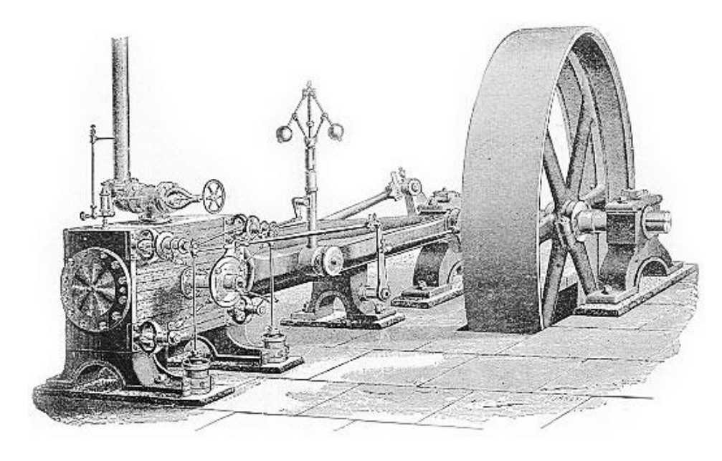
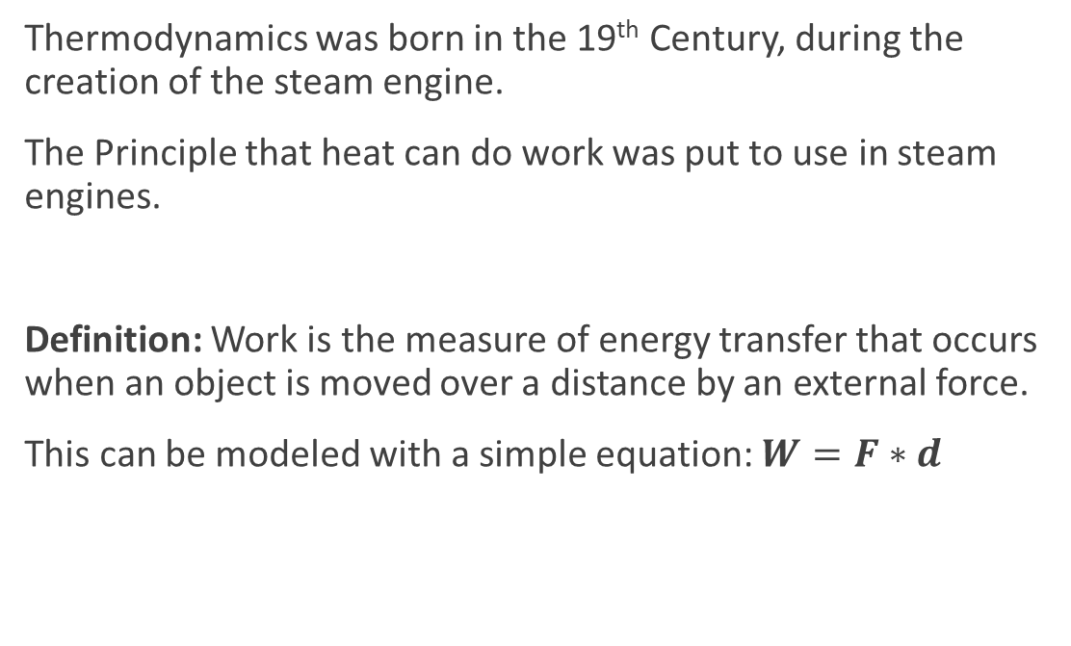
Chapter 1 Introduction to Concepts and Definitions
Thermodynamics was born in the 19th Century, during the creation of the steam engine.
The Principle that heat can do work was put to use in steam engines.
Definition: Work is the measure of energy transfer that occurs when an object is moved over a distance by an external force.
This can be modeled with a simple equation: $W=F∗d$
Example of a Steam Engine
in the 19th century

Slide 10
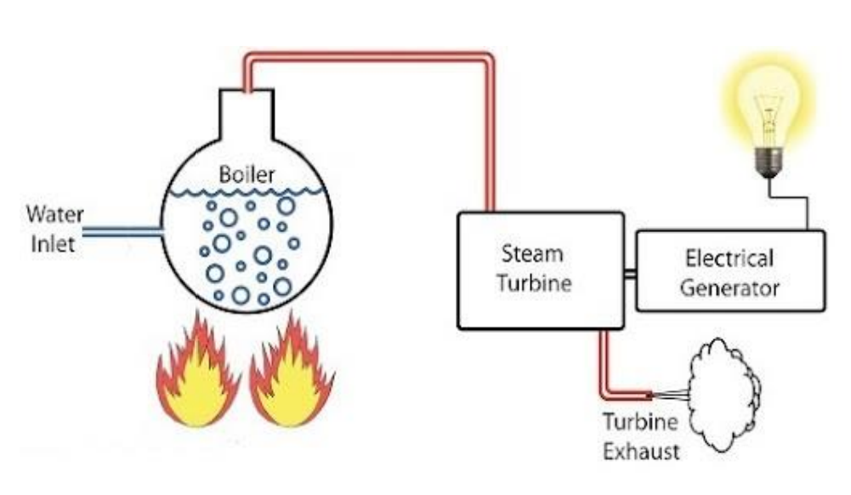
Chapter 1 Introduction to Concepts and Definitions
Definition: Thermodynamics is the Study of systems through which matter flows and the interaction of material going through the system and their reaction to their surroundings
Flow of Matter in a System

Slide 11
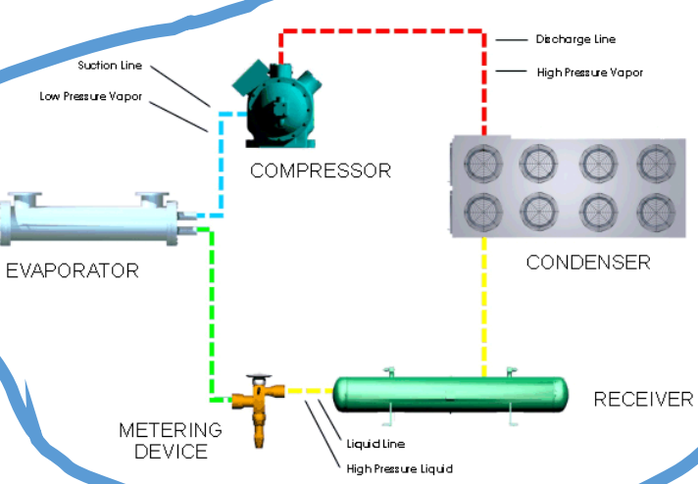
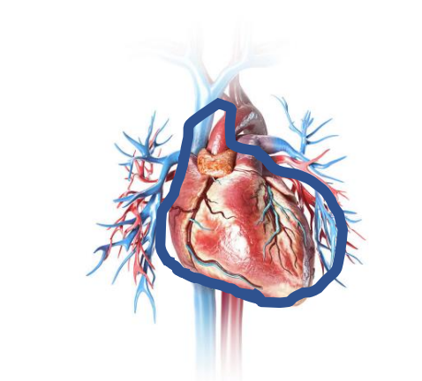
Chapter 1 Introduction to Thermodynamic Systems
Definition: A Closed System is a system in which the matter does not flow in or out of it.
Definition: An Open System is a system in which the matter can flow in or out of it.
Example of a Closed System.
A refrigerator Cooling System has no matter flowing in or out.
Example of an Open System.
A heart has matter(blood) flowing in and out of it.
A better example would be that a pump is an open System.

Slide 12
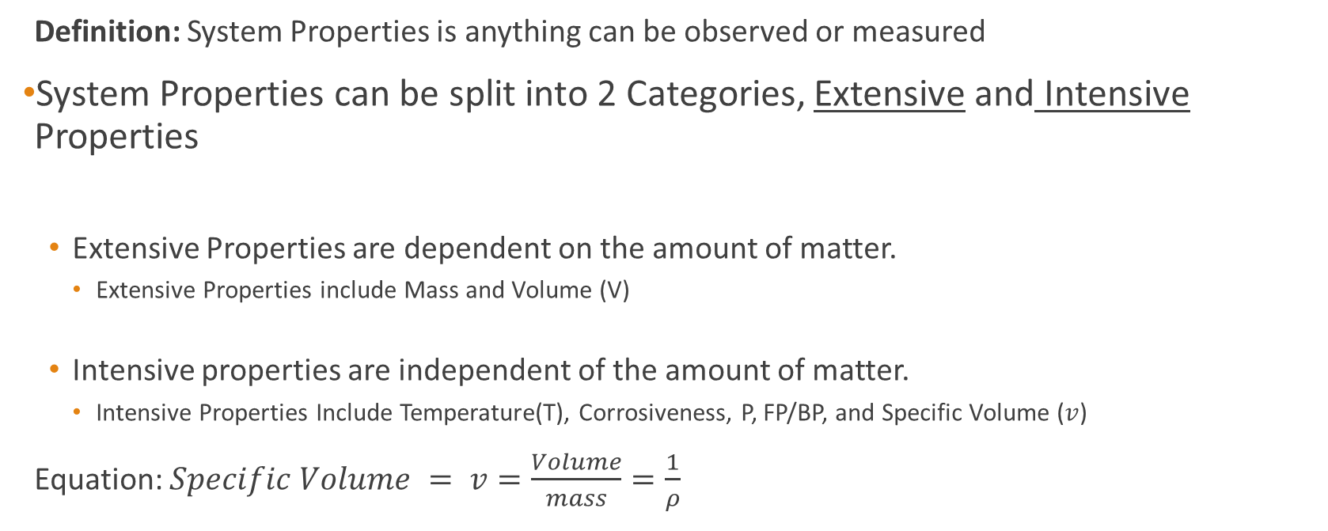
Chapter 1 Introduction to System Properties
Definition: System Properties is anything can be observed or measured
System Properties can be split into 2 Categories, Extensive and Intensive Properties
Extensive Properties are dependent on the amount of matter.
Extensive Properties include Mass and Volume (V)
Intensive properties are independent of the amount of matter.
Intensive Properties Include Temperature(T), Corrosiveness, P, FP/BP, and Specific Volume ($v$)
Equation: $Specific Volume = v=\frac{Volume}{mass}=\frac{1}{ρ}$

Slide 13
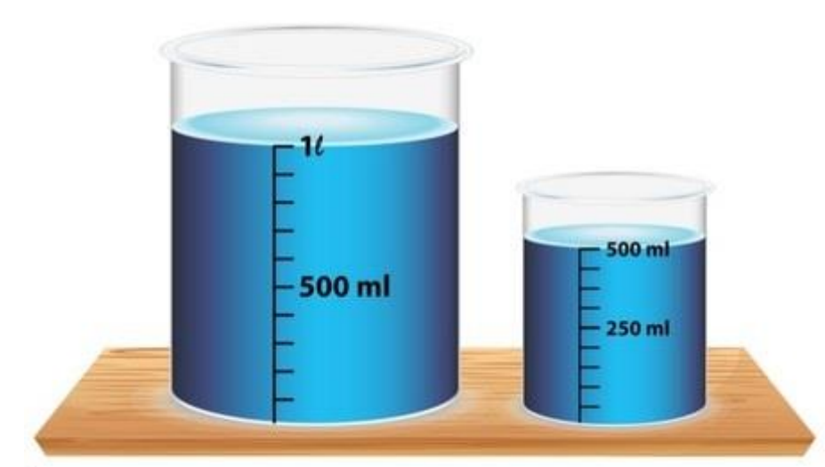
Chapter 1 Introduction to System Properties
Example:
What can be observed about the matter in these beakers?
- Color
- Temperature
- Mass
- Volume
- Corrosiveness
- Freezing point/Boiling point
Which Properties are Extensive and which are Intensive?

Slide 14
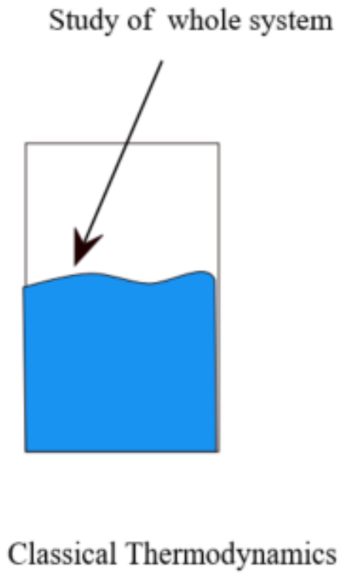
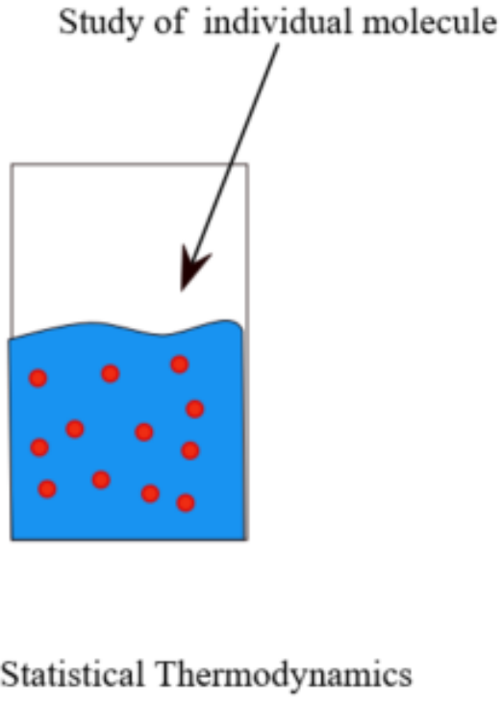
Chapter 1 Thermodynamic Approaches
There are 2 main Approaches to Thermodynamics:
Classical Thermodynamics
The description of the states of thermodynamic systems at near-equilibrium, that uses macroscopic, measurable properties. It is used to model exchanges of energy, work and heat based on the Laws of Thermodynamics.
Statistical Thermodynamics
Statistical thermodynamics, emerged with the development of atomic and molecular theories in the late 19th century and early 20th century, and supplemented classical thermodynamics with an interpretation of the microscopic interactions between individual particles or quantum-mechanical states.

Slide 15

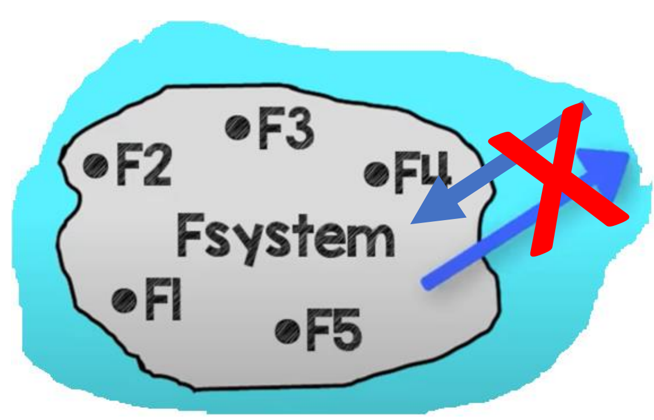
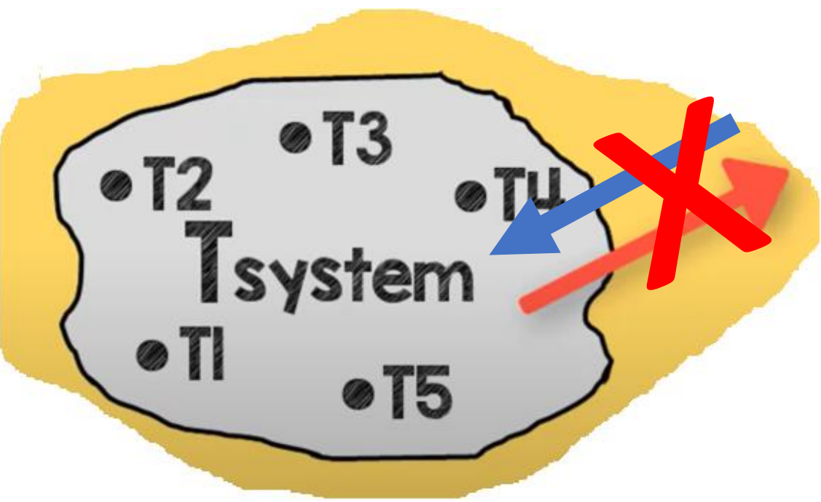
Chapter 1 Thermodynamics Equilibrium
Definition: Thermodynamics Equilibrium is a state of system in which it is in chemical, mechanical and thermal equilibrium
Chemical Equilibrium :
- No chemical reaction
- No change in composition
- No change in formula
Mechanical Equilibrium:
- No unbalanced force within the system
- No force flow
Thermal Equilibrium:
- No unbalanced temperature within the system
- No temperature flow

Slide 16
Chapter 1 Units in Thermodynamics
Metric Units (S.I)
English Units (USCS)
Quantity | Units | Symbol
Mass | Kilograms | Kg
Length | Meter | M
Time | Second | S
Force | Newton | N
Temperature | Kelvin | K
Pressure | Pascal | Pa
Quantity | Units | Symbol
Mass | Pound mass | lbm
Length | Foot | ft
Time | Second | s
Force | Pound Force | lbF
Temperature | Fahrenheit | F
Pressure | Pound per sq. inch | psi(ksi)

Slide 17
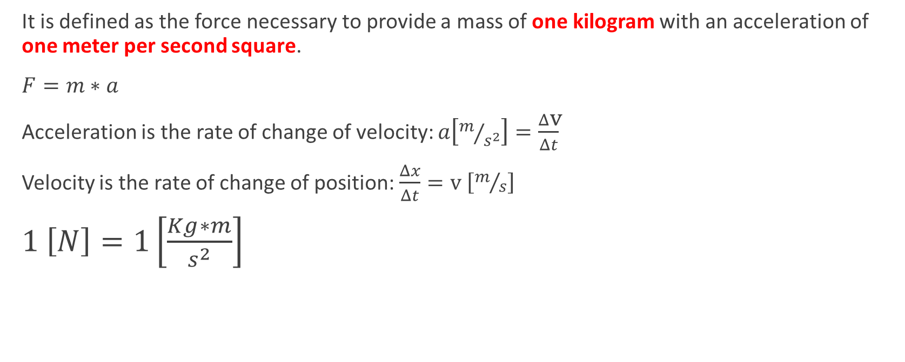
Chapter 1 Introduction to the Newton
It is defined as the force necessary to provide a mass of one kilogram with an acceleration of one meter per second square.
$F=m∗a$
Acceleration is the rate of change of velocity: $a\left[m/{s^{2}}\right]=\frac{Δ\text{v}}{Δt}$
Velocity is the rate of change of position: $\frac{Δx}{Δt}=\text{v} \left[m/s\right]$
$1 \left[N\right]=1\left[\frac{Kg∗m}{s^{2}}\right]$

Slide 18
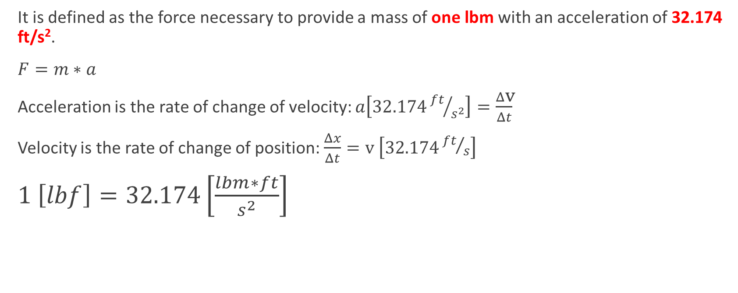
Chapter 1 Introduction to the Pound-Force
It is defined as the force necessary to provide a mass of one lbm with an acceleration of 32.174 ft/s².
$F=m∗a$
Acceleration is the rate of change of velocity: $a\left[32.174{ft}/{s^{2}}\right]=\frac{Δ\text{v}}{Δt}$
Velocity is the rate of change of position: $\frac{Δx}{Δt}=\text{v} \left[32.174{ft}/s\right]$
$1 \left[lbf\right]=32.174\left[\frac{lbm∗ft}{s^{2}}\right]$

Slide 19
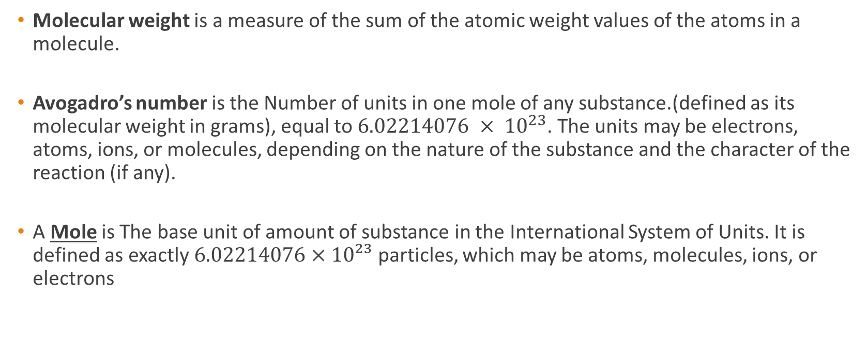
Chapter 1 Introduction to Molecular Weight
Molecular weight is a measure of the sum of the atomic weight values of the atoms in a molecule.
Avogadro’s number is the Number of units in one mole of any substance.(defined as its molecular weight in grams), equal to $6.02214076 × {10}^{23}$. The units may be electrons, atoms, ions, or molecules, depending on the nature of the substance and the character of the reaction (if any).
A Mole is The base unit of amount of substance in the International System of Units. It is defined as exactly $6.02214076×10²³$ particles, which may be atoms, molecules, ions, or electrons

Slide 20
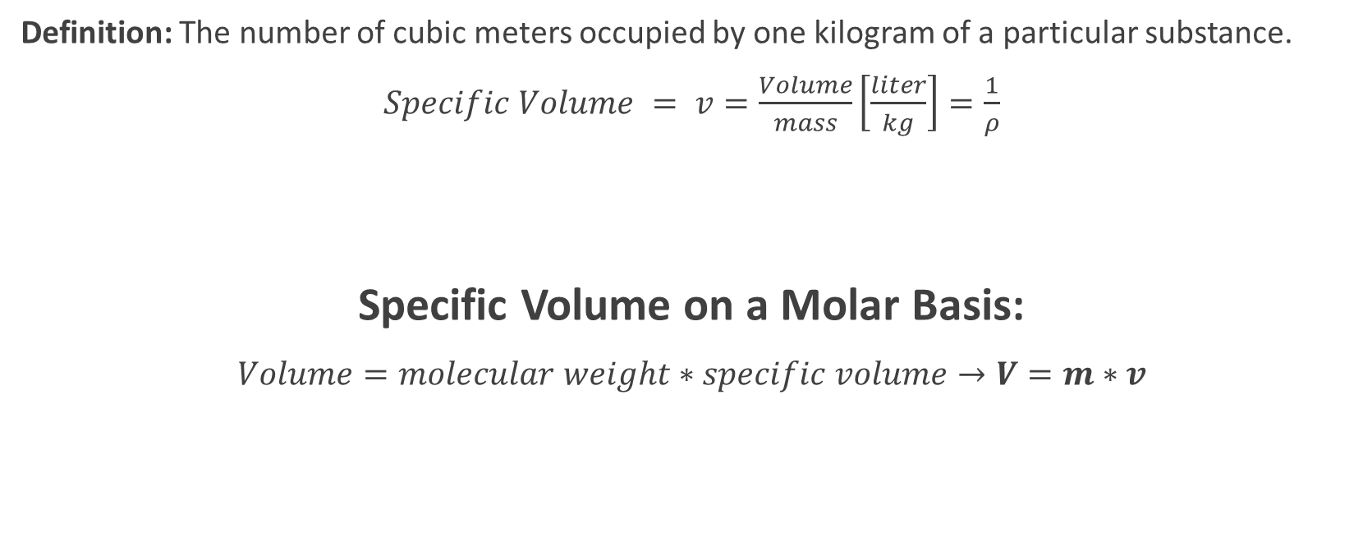
Chapter 1 Introduction to Specific Volume
Definition: The number of cubic meters occupied by one kilogram of a particular substance.
$Specific Volume = v=\frac{Volume}{mass}\left[\frac{liter}{kg}\right]=\frac{1}{ρ}$
Specific Volume on a Molar Basis:
$Volume=molecular weight∗specific volume→V=m∗v$

Slide 21
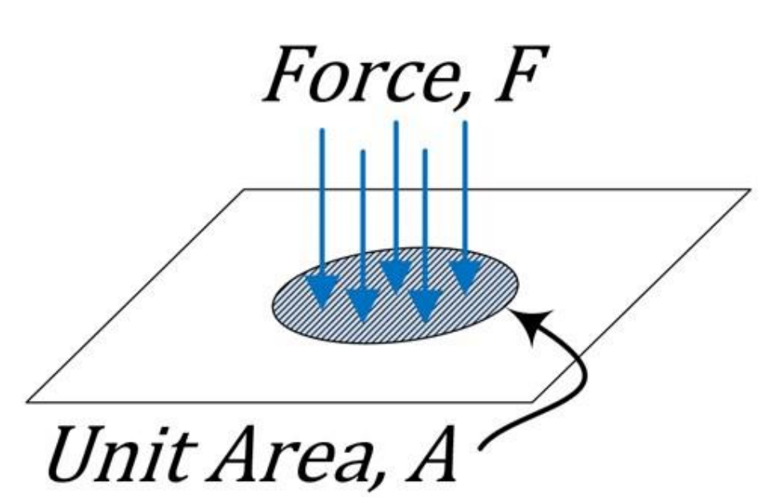
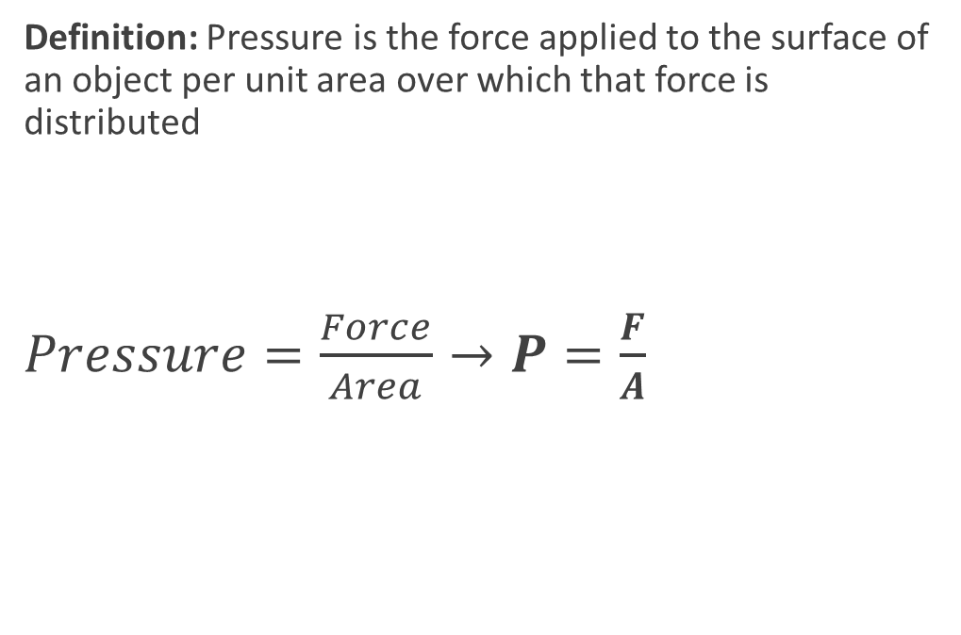
Chapter 1 Introduction to Pressure
Definition: Pressure is the force applied to the surface of an object per unit area over which that force is distributed
$Pressure=\frac{Force}{Area}→P=\frac{F}{A}$

Slide 22
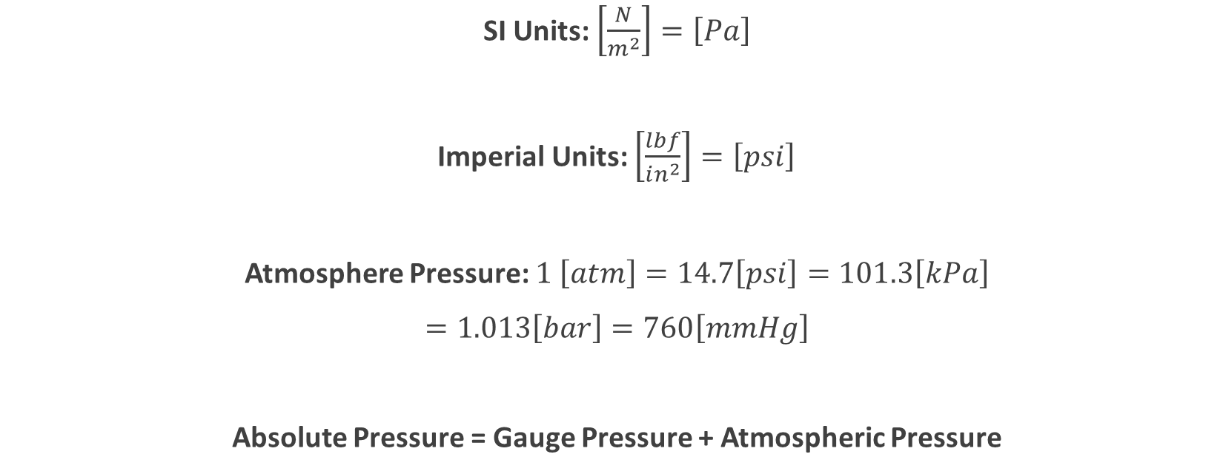
Chapter 1 Common Units of Pressure
SI Units: $\left[\frac{N}{m^{2}}\right]=\left[Pa\right]$
Imperial Units: $\left[\frac{lbf}{in^{2}}\right]=\left[psi\right]$
Atmosphere Pressure: $1 \left[atm\right]=14.7\left[psi\right]=101.3\left[kPa\right]$
$=1.013\left[bar\right]=760\left[mmHg\right]$
Absolute Pressure = Gauge Pressure + Atmospheric Pressure

Slide 23
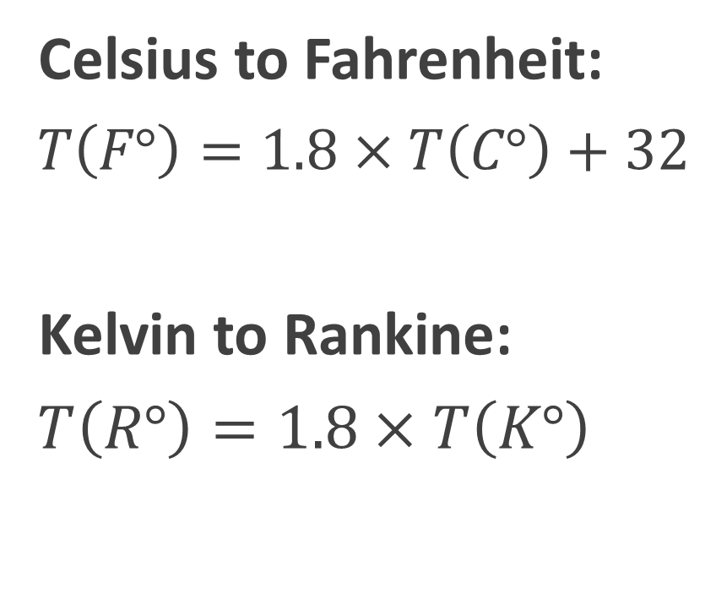
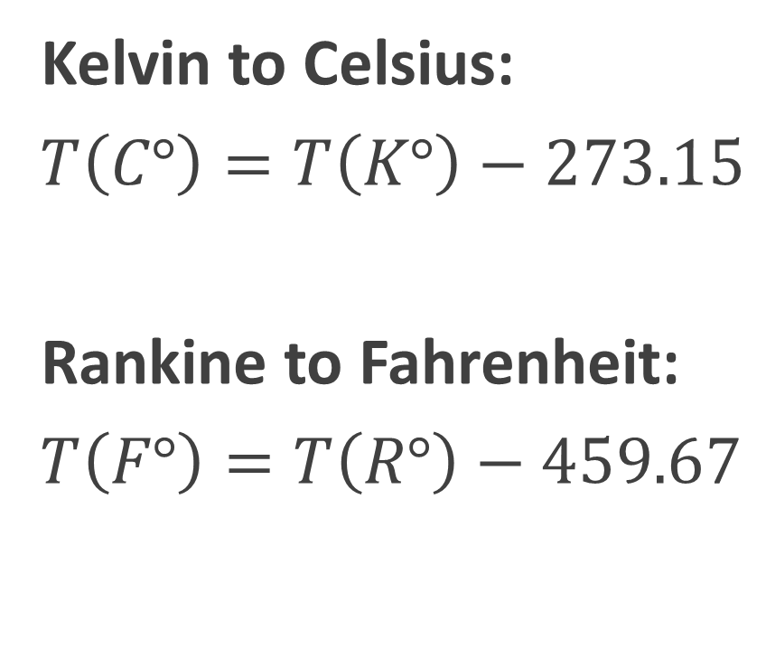
Chapter 1 Introduction To Temperature Conversion
Kelvin to Celsius:
$T\left(C°\right)=T\left(K°\right)−273.15$
Rankine to Fahrenheit:
$T\left(F°\right)=T\left(R°\right)−459.67$
Celsius to Fahrenheit:
$T\left(F°\right)=1.8×T\left(C°\right)+32$
Kelvin to Rankine:
$T\left(R°\right)=1.8×T\left(K°\right)$

Slide 24
Chapter 1 End of Introduction
QUESTIONS?

